Slide 1
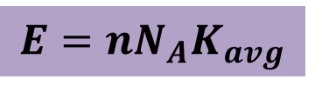
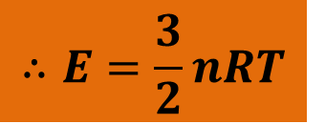
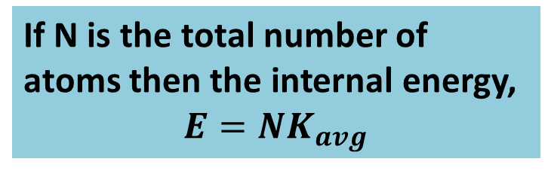
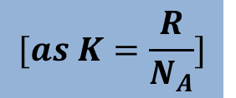
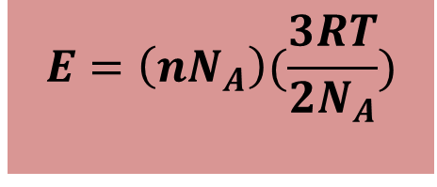
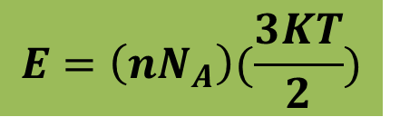
Internal Energy of an Ideal Gas
Consider n mole of monatomic ideal gas. The internal energy of the gas is the sum of the translational kinetic energies of the atoms.
If N is the total number of atoms then the internal energy,
$$E=NK_{avg}$$
$$E=\left(nN_{A}\right)(\frac{3RT}{2N_{A}})$$
$$E=nN_{A}K_{avg}$$
$$[as K=\frac{R}{N_{A}}]$$
$$E=\left(nN_{A}\right)(\frac{3KT}{2})$$
$$∴E=\frac{3}{2}nRT$$

Slide 2
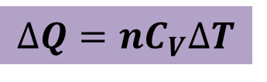
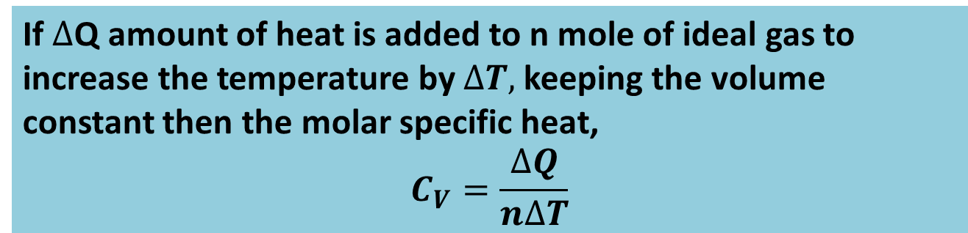


Molar Specific Hea tat Constant Volume
If $∆$Q amount of heat is added to n mole of ideal gas to increase the temperature by $∆T,$keeping the volume constant then the molar specific heat,
$$C_{V}=\frac{∆Q}{n∆T}$$
$$∆Q=nC_{V}∆T$$
The Work done at constant volume,
$$∆W=0$$
The change in internal energy of the system,
$$∆E=\frac{3}{2}nR∆T$$

Slide 3
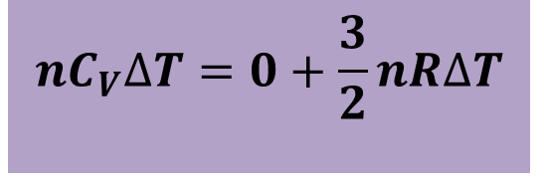

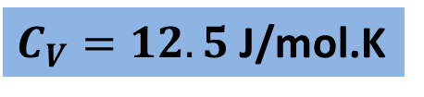
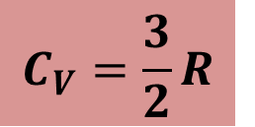
From the 1st law of thermodynamics,
$$∆Q=∆W+∆E$$
$$nC_{V}∆T=0+\frac{3}{2}nR∆T$$
$$C_{V}=\frac{3}{2}R$$
$C_{V}=12.5$J/mol.K

Slide 4

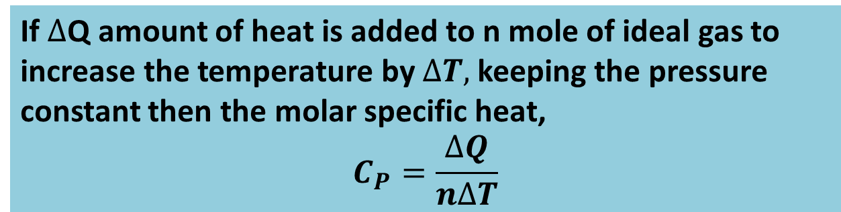


Molar Specific Heat at Constant Pressure
If $∆$Q amount of heat is added to n mole of ideal gas to increase the temperature by $∆T,$keeping the pressure constant then the molar specific heat,
$$C_{P}=\frac{∆Q}{n∆T}$$
$$∆Q=nC_{P}∆T$$
The Work done at constant pressure,
$$∆W=P∆V$$
The change in internal energy of the system,
$$∆E=\frac{3}{2}nR∆T$$

Slide 5
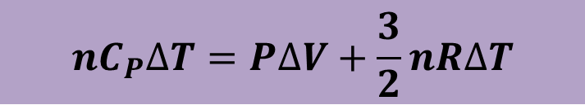
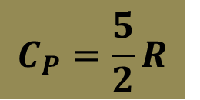

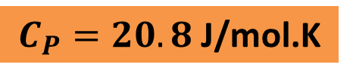
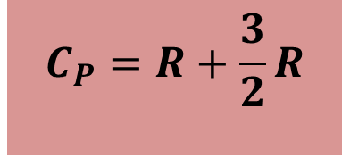

From the 1st law of thermodynamics,
$$∆Q=∆W+∆E$$
$$nC_{P}∆T=P∆V+\frac{3}{2}nR∆T$$
$$nC_{P}∆T=nR∆T+\frac{3}{2}nR∆T$$
$$C_{P}=R+\frac{3}{2}R$$
$$C_{P}=\frac{5}{2}R$$
$$C_{P}=20.8 \text{J}\text{/}\text{mol}\text{.}\text{K}$$

Slide 6
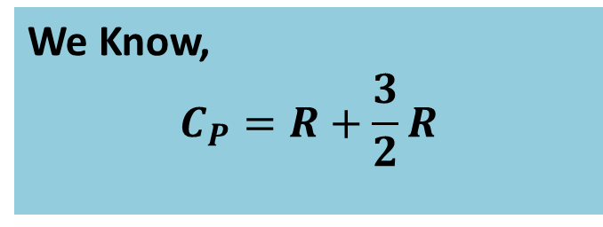

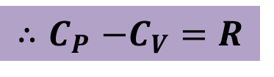
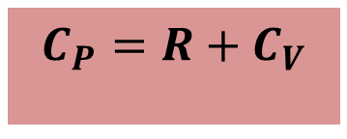
Relation Between $C_{P}$and $C_{V}$
We Know,
$$C_{P}=R+\frac{3}{2}R$$
$$C_{P}=R+C_{V}$$
$${∴C}_{P}−C_{V}=R$$

Slide 7

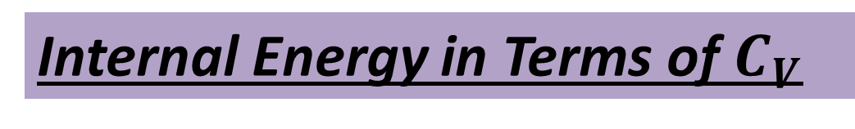

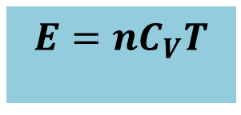
Internal Energy in Terms of $C_{V}$
Internal energy,
$$E=\frac{3}{2}nRT$$
$$E=nC_{V}T$$
The change in internal energy,
$$∆E=nC_{V}∆T$$

